Slide 1




Assessment of the additional shear demand due to infills through a refined micromodel
F. Di Trapani¹, V. Bogatkina¹, M. Petracca², G. Camata³
Dipartimento di Ingegneria Strutturale, Edile e Geotecnica, Politecnico di Torino¹
ASEDA Sofware, Pescara²
Universtà G. D’Annunzio di Chieti e Pescara³

Slide 2

^{Title of the presentation}

Slide 3
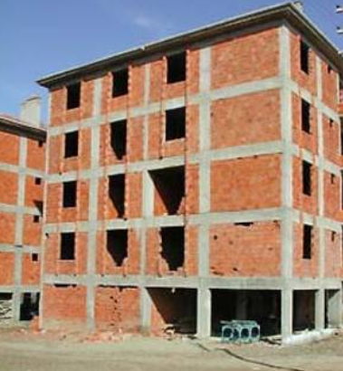
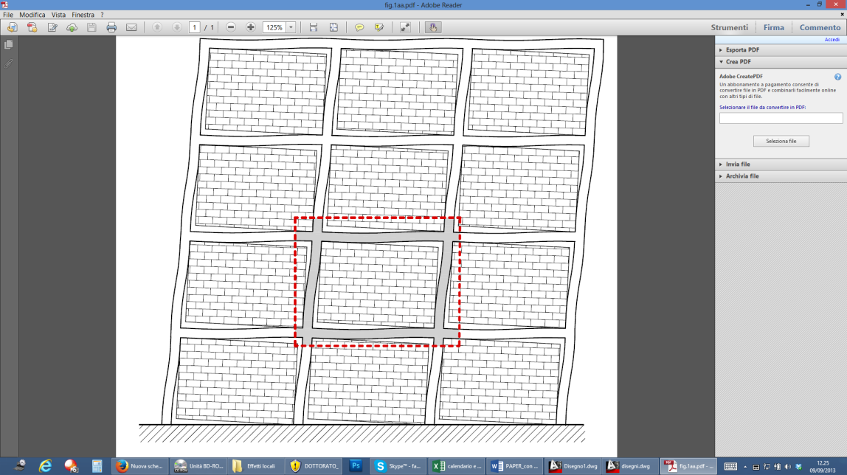
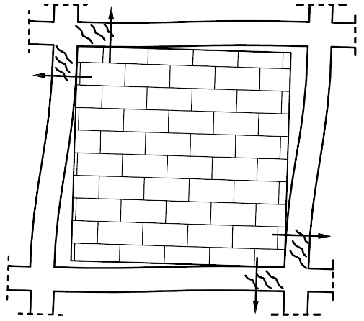
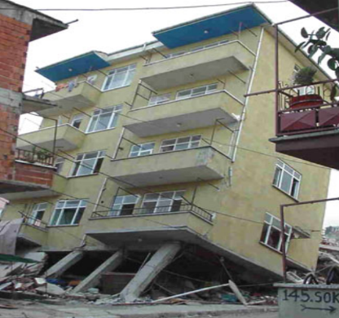
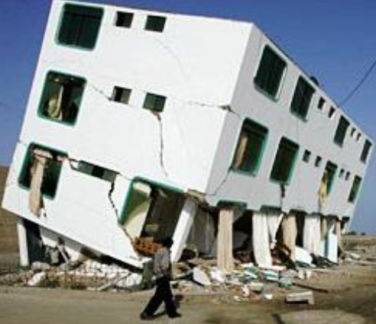
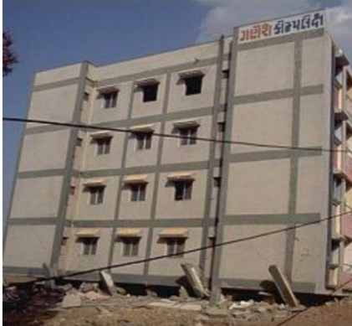
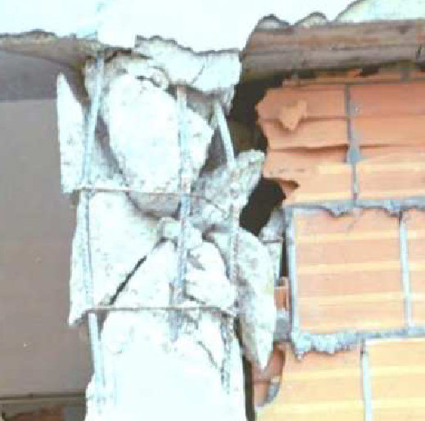
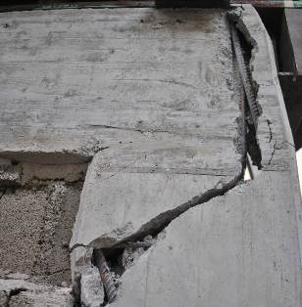
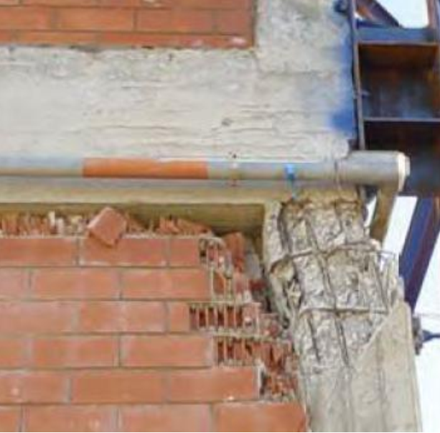
Definition of the problem
INFLUENCE OF MASONRY INFILL WALLS ON SEISMIC RESPONSE OF RC STRUCTURES
GLOBAL INTERACTION EFFECTS
LOCAL INTERACTION EFFECTS
BENEFICIAL
Increment in stiffness
Improvement of bearing capacity
ADVERSE
Torsional effects
Soft storey mechanism
ADVERSE (transverse reinforcement is not sufficient)
Notes:
First, I would like to give you a short introduction about the reasons why this topic is important, why the problem is relevant and what are the motivations below this study. Usually, the influence of an infill is neglected, since it is a non-structural part of the building, but latest researches and observations after earthquakes showed that the infills should be considered, since they can have either beneficial or adverse effects on the structure depending on their distribution in plane and over the height. Adverse such as torsional effects and soft storey mechanism. And beneficial such as the increase in stiffness and bearing capacity. But this positive effect is possible only if the frame were designed with an adequate seismic reinforcement. Otherwise, the local interaction would lead to the brittle collapse mechanism as it can be seen on these images.

Slide 4
Definition of the problem
INFLUENCE OF MASONRY INFILL WALLS ON SEISMIC RESPONSE OF RC STRUCTURES
MACRO-MODEL
1D frame and the infill is modelled as
one equivalent strut
MICRO-MODEL
2D FEM modelling of the frame and infill
ADVANTAGES
Simple linear and nonlinear identification
Low computational effort
ADVANTAGES
Local shear effects are evaluable
DISADVANTAGES
Difficult linear and nonlinear identification
High computational effort
DISADVANTAGES
Local shear effects are not evaluable
Notes:
To consider the infill two main approaches are known: a macro-model where 1-dimensional elements, used for the frame and the infill, are substituted with one or more diagonal strut. The second approach is a micro-model, where a more complicated 2-dimensional finite element model is used for frame and infill. The both models multiple strut model and micro-model is not convenient to apply practically as … So the macro-model with just one strut is the best choice for engineering application due to its simplicity and lower computational time. But the problem is that in comparison to others the one-strut model is not able to predict the additional shear on the frame due to the influence of the infill. So, objective of this thesis to develop an analytical solution that will provide an additional shear demand for the simplified macro-model, validated on the micro-model that instead can replicate the real behaviour of the frame and provide the additional shear demand on the beams and columns

Slide 5
Definition of the problem
INFLUENCE OF MASONRY INFILL WALLS ON SEISMIC RESPONSE OF RC STRUCTURES
MACRO-MODEL
1D frame and the infill is modelled as
one equivalent strut
MICRO-MODEL
2D FEM modelling of the frame and infill
ADVANTAGES
Simple linear and nonlinear identification
Low computational effort
ADVANTAGES
Local shear effects are evaluable
DISADVANTAGES
Difficult linear and nonlinear identification
High computational effort
Thesis objective: development of analytical solution that takes into account additional shear demand for the simplified macro-model
Notes:
To consider the infill two main approaches are known: a macro-model where 1-dimensional elements, used for the frame and the infill, are substituted with one or more diagonal strut. The second approach is a micro-model, where a more complicated 2-dimensional finite element model is used for frame and infill. The both models multiple strut model and micro-model is not convenient to apply practically as … So the macro-model with just one strut is the best choice for engineering application due to its simplicity and lower computational time. But the problem is that in comparison to others the one-strut model is not able to predict the additional shear on the frame due to the influence of the infill. So, objective of this thesis to develop an analytical solution that will provide an additional shear demand for the simplified macro-model, validated on the micro-model that instead can replicate the real behaviour of the frame and provide the additional shear demand on the beams and columns

Slide 6
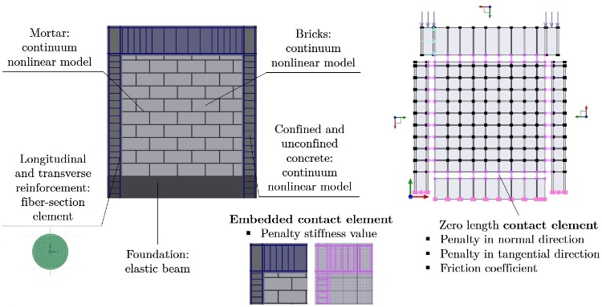
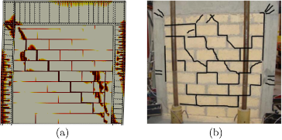
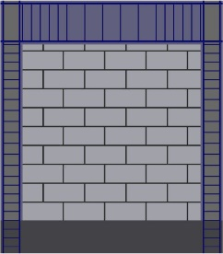
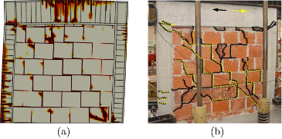
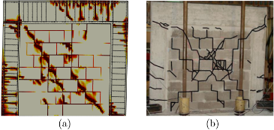
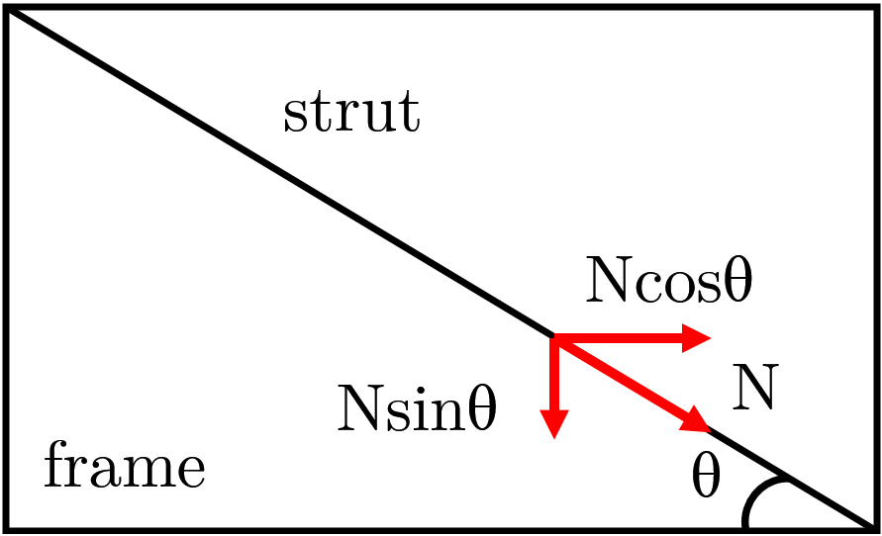
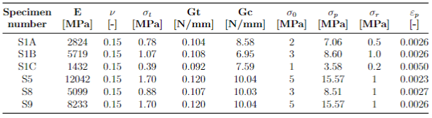

Strategy
Refined micro-model
Model calibration
Analytical solution
Cut 1
Cut 2
Cut 3
Cut 4
Cut 5
Cut 6
$$V_{tot}=V+N\cos{θ}−μN\sin{θ\frac{αl}{w}}$$
Refined micro-model: FEM model that able to simulate frame infilled interaction with the friction and with a possible detachment between them
Model calibration: by using two sets of experimental data with different types of masonry and aspect ratio
Analytical solution: a proposal for the analytical solution of the additional shear that will be applied to the macro-model
Notes:
Now I would like to introduce you the Strategy followed in this work. First, to create the refined micro-model that is able to simulate the frame-infill interaction with the friction and with a possible detachment of the masonry panel from the frame. Then, the calibration and validation of the model by using experimental data. And finally a proposal for the analytical solution of the additional shear that will be applied to the macro-model.

Slide 7
Refined micro-model
Refined micro-model
Model calibration
Analytical solution
Cut 1
Cut 2
Cut 3
Cut 4
Cut 5
Cut 6
$$V_{tot}=V+N\cos{θ}−μN\sin{θ\frac{αl}{w}}$$
Software:
OpenSees: open source software framework from University of California, Berkeley
STKO: Scientific Toolkit for OpenSees developed by Asdea Software Technology, Pescara.
Notes:
To create the refined non-linear numerical model of the single frame the open source software framework OpenSees that was developed by Frank McKenna, University of California, was chosen as it gives a wide range of possibilities to simulate the response of structural systems subjected to seismic actions.
As OpenSees does not have its own pre and post-processors and works by writing TCLfiles, to simplify the modelling the STKO software was used. STKO is a Scientific Toolkit for OpenSees developed by Asdea Software Technology in Pescara. The software contains many innovative features such as a Python scripting interface, computer-aided design (CAD) modeling tools, advanced visualization algorithms and an opensource database library for storing results which includes an MPCORecorder.

Slide 8
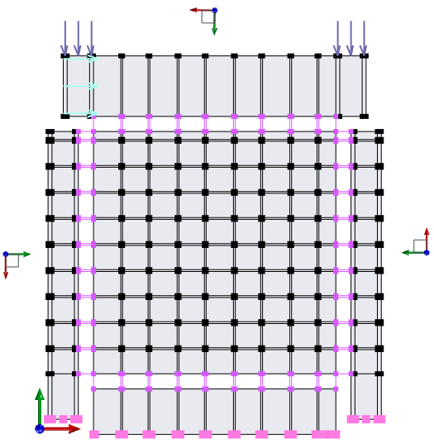
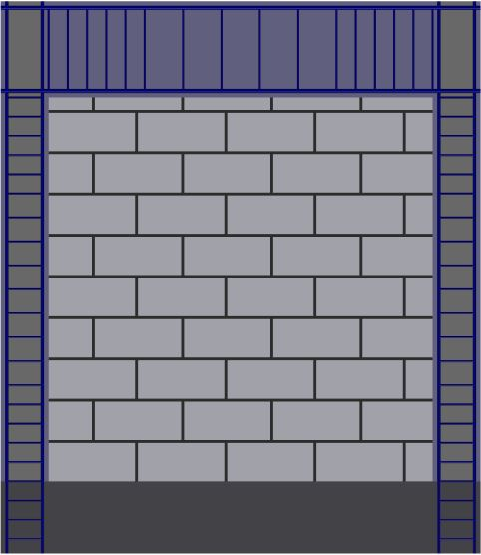
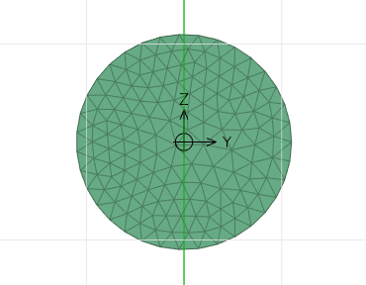
Refined micro-model
Mortar: continuum nonlinear model
Bricks: continuum nonlinear model
Confined and unconfined concrete:
continuum nonlinear model
Longitudinal and transverse reinforcement: fiber-section element
Zero length contact element
Penalty in normal direction
Penalty in tangential direction
Friction coefficient
Foundation: elastic beam
Notes:
The single frame was modeled in 2D. To simulate mortar, bricks and concrete the nonlinear continuum model was chosen. To introduce a reinforcement into the frame the fiber section element with Lobatto integration was used and since concrete and bars were modelled as two separate bodies, the embedded contact element was necessary. This enforced the constraints between two bodies by applying a penalty stiffness value. For the foundation, the elastic beam was used since no damage was expected.
On the right figure the zerolength contact element can be seen which simulates the frame-infill interaction, by applying a penalty in the normal and tangential directions, and the friction coefficient.

Slide 9
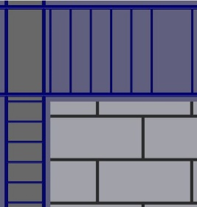
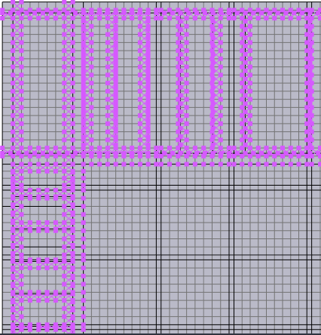
Refined micro-model
Mortar: continuum nonlinear model
Bricks: continuum nonlinear model
Confined and unconfined concrete:
continuum nonlinear model
Longitudinal and transverse reinforcement: fiber-section element
Embedded contact element
Penalty stiffness value
Zero length contact element
Penalty in normal direction
Penalty in tangential direction
Friction coefficient
Notes:
The single frame was modeled in 2D. To simulate mortar, bricks and concrete the nonlinear continuum model was chosen. To introduce a reinforcement into the frame the fiber section element with Lobatto integration was used and since concrete and bars were modelled as two separate bodies, the embedded contact element was necessary. This enforced the constraints between two bodies by applying a penalty stiffness value. For the foundation, the elastic beam was used since no damage was expected.
On the right figure the zerolength contact element can be seen which simulates the frame-infill interaction, by applying a penalty in the normal and tangential directions, and the friction coefficient.

Slide 10
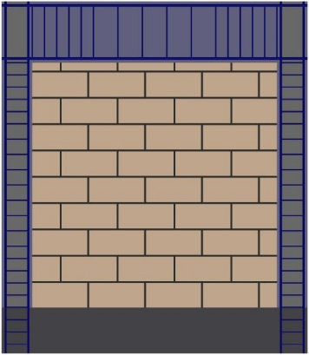
Refined micro-model
Simulation of experimental test
Analysis Settings and Conditions
Analysis Type: Static
Constraint Handler: Transformation method
Numberer Type: Parallel Reverse Cuthill-McKee
System Command: Mumps
Solution Algorithm: Krylov-Newton
Convergence Test: Norm Displacement Increment
Adaptive Time Step
Integrator: Parallel Displacement Control
Notes:
For masonry and concrete the Damage Tension Compression constitutive model was used. It is based on the continuum damage mechanics. This model introduces two failure criteria for tensile and compressive stress states as well as two scalar damage indexes, allowing the description of different behaviors under tension and compression. In the table some parameters for the bricks are reported, such as tensile and compressive strength of the material and the fracture energies. These energies can be calculated with the formulations shown here. For the reinforcement the well known model Steel02 was used with the hardening set equal to 1%.
The analysis settings and conditions are listed on the right column, just to show that the analysis is totally under the control of the user. For example, to decrease the computational time the Krylov-Newton algorithm was chosen to solve the non-linear equation, since in this case the stiffness is always the same.
Also, a partition was used that allowed to run the analysis with more than one processors simultaneously and to decrease the computational time.
At the end, a simple pushover analysis was performed. The base of the frame was fixed, then a constant vertical load was applied to the frame and finally an horizontal force increasing monotonically was applied as well. The displacement of the top of the frame was measured and plotted as a function of the reaction force at the base.

Slide 11
Model calibration
Refined micro-model
Model calibration
Analytical solution
Cut 1
Cut 2
Cut 3
Cut 4
Cut 5
Cut 6
$$V_{tot}=V+N\cos{θ}−μN\sin{θ\frac{αl}{w}}$$
Two sets of experimental data:
Dataset 1: S1A, S1B, S1C specimens (Cavaleri and Di Trapani, 2014)
Dataset 2: 5, 8, 9 specimens (Mehrabi et al., 1996)
Notes:
As an experimental background, two sets of specimens were considered from Cavaleri, Di Trapani, 2014 and Mehrabi et. Al, 1996: they will be referenced to as Dataset 1 and Dataset 2, respectively. In particular, these experiments were chosen due to their completeness of information and variety of cases. In Dataset 1 RC frames arranged with different types of masonry are considered: calcarenite, clay and lightweight concrete masonry. The specimens from Dataset 2 were representative since they combined different complicated failure mechanisms such as the shear failure of columns, the diagonal crack, the corner crushing with cracks in the infills and the slip at the joints

Slide 12
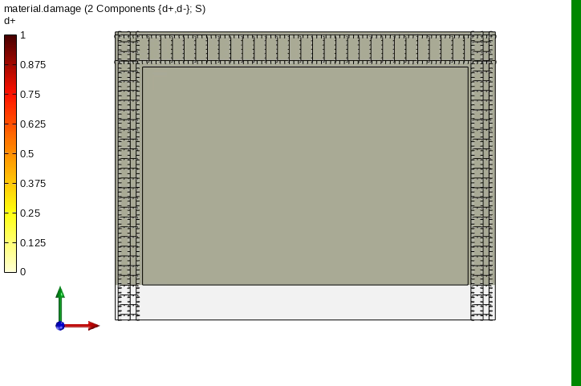

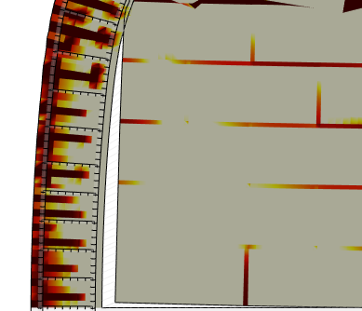
Model calibration
Specimen S1A Calcanerite masonry, aspect ratio l/h=1 (Cavaleri and Di Trapani, 2014)
Pushover curves
Material damage d+
Failure mechanism
References | Specimen number | K_{n} [N/mm] | K_{t} [N/mm] | µ [-]
Cavaleri and Di Trapani (2014) | S1A | 75000 | 75000 | 0.7
Detachment zone
Notes:
Some calibrations were performed with the parameters that led to the best fitting of the numerical curve to the experimental ones, such as the contact parameters and the residual strength parameters of the materials. Since their values cannot be obtained from laboratory tests or analytically computed, they were assumed based on previous research and calibrated. On the right the failure mechanism of the specimen S1A can be seen. The gray color represents no damage and the red one full damage for the tension. As expected the specimen has a diagonal crack, the sliding at the mortar joints, some brick crashes and cracks close to joints.

Slide 13

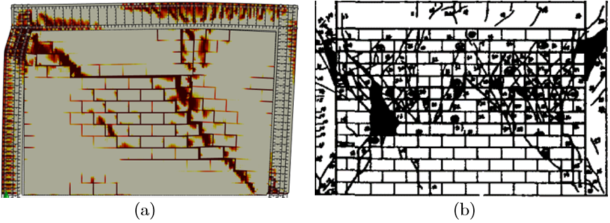

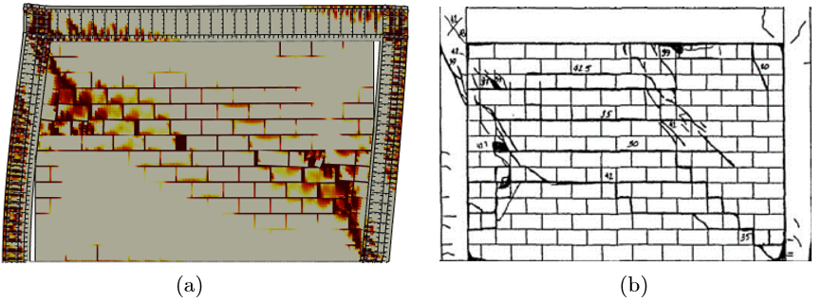
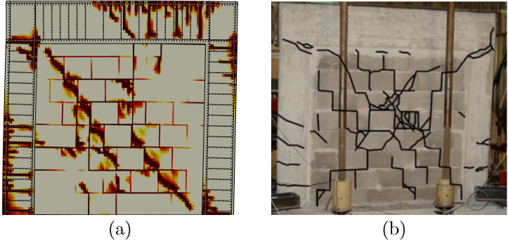
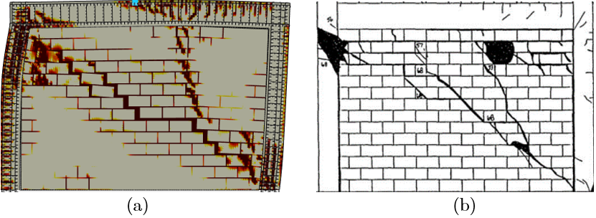
Model calibration
DATASET 1
Cavaleri and Di Trapani, 2014
l/h=1
DATASET 2
Mehrabi et al., 1996
l/h=1.43
Specimen S1A (calcarenite masonry)
Specimen S1B (clay masonry)
Specimen S1C (ligtweight concrete)
Specimen 5 (solid bricks)
Specimen 8 (hollow bricks)
Specimen 9 (solid bricks)
Notes:
In this slide the failure mechanism for all the specimens are represented. Some specimens were subjected to cyclic loads, however, as a simplified study, the envelope of the experimental cyclic response was considered, and a simulation was performed under a monotonic loading.

Slide 14
Model calibration
Pushover curves
DATASET 1
DATASET 2
Notes:
On these graphs it can be seen that the numerical curves are in good agreement with the experimental ones.

Slide 15
Analytical solution
Refined micro-model
Model calibration
Analytical solution
Cut 1
Cut 2
Cut 3
Cut 4
Cut 5
Cut 6
$$V_{tot}=V+N\cos{θ}−μN\sin{θ\frac{αl}{w}}$$
Analytical solution objectives:
Methodology of shear measurement in 2D continuum model
Proposal of an analytical relationship to predict the additional shear Validation of the solution
Notes:
In the last part, I would like to say a few words about the methodology for the shear measurement in the 2D continuum model since this is not easy to perform and finally I would like to show the proposed analytical relationship to predict the additional shear.

Slide 16
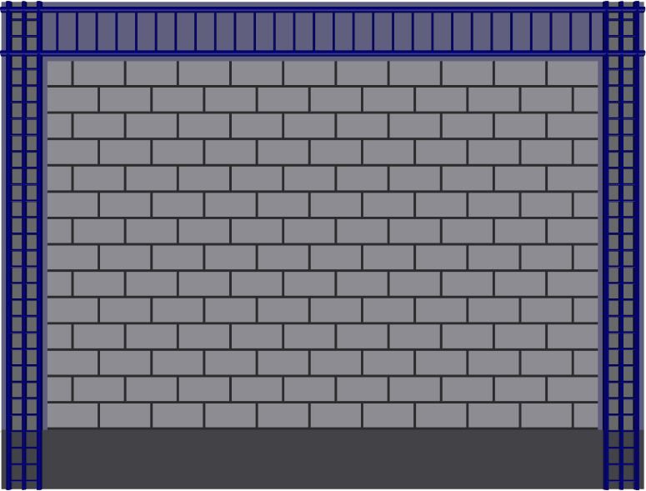
Shear from numerical model
METHODOLOGY OF SHEAR MEASUREMENT IN 2D CONTINUUM MODEL
Specimen 9
Cuts 4-6
Cut 1
Cut 2
Cut 3
Cuts 1-3
Cut 6
Cut 5
Cut 4
Notes:
Regarding the shear there are critical zones, which are of greater interest. In the presence of seismic actions, the infill panel partially detaches from the frame, remaining in contact with it only near two opposite corners as it is shown in the left figure. To be able to measure the shear demand in those specific zones of the 2D continuum model, the TCL script was implemented, that allows to specify the set of nodes and to collect the internal forces in X and Y directions for each element and to integrate them along the section. The cuts should be defined a priory as it is shown in the right figure. In this case only the columns are considered based on the experimental data. Three cuts were performed for each critical zone and the average value was used instead of the maximum, not to overestimate the shear demand, since the high value of demand at one section will not lead to the failure. The shear capacities are shown as reference; they are calculated by the Biskinis formulation from Eurocode 8 and by the Sezen and Moehle formulation.

Slide 17
Shear from numerical model
Left column Right column
Left column Right column
Specimen S1A
Specimen 5
Specimen S1B
Specimen 8
DATASET 1
DATASET 2
Specimen S1C
Specimen 9
Notes:
The procedure was applied to all the specimens.

Slide 18
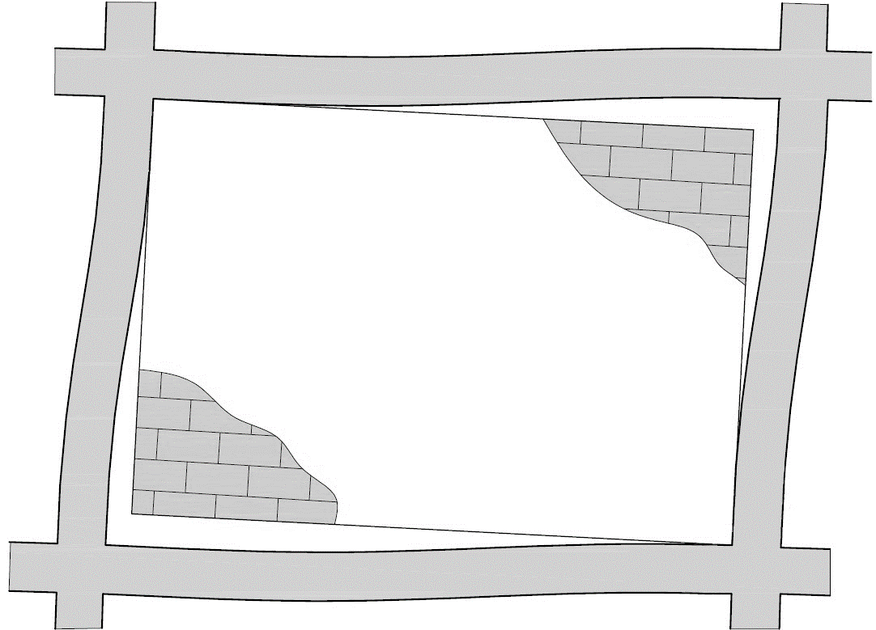
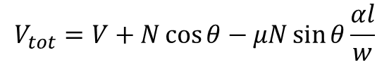
Analytical solution
Ncosθ
V_{frame}
Nsinθ
N
V_{infill}
θ
V_{tot}
μNsinθ
$$V_{tot}=V+N\cos{θ}−μN\sin{θ\frac{αl}{w}}$$
Notes:
Based on the axial normal force in the diagonal strut of the macro-model, the friction coefficient, angle of strut inclination and width of the strut with the application of some coefficients that depend on the frame-infill contact zones the proposed analytical expression is reported. On the graphs in blue and red the analytical and numerical shear demand are reported, respectively. They showed a good agreement. In black two other analytical solutions are reported for comparison purposes: Cavaleri and Di Trapani 2015 and Di Trapani et al. 2018

Slide 19
Analytical solution
Left column Right column
Left column Right column
Specimen S1A
Specimen 5
Specimen S1B
Specimen 8
DATASET 1
DATASET 2
7%
Specimen S1C
Specimen 9
Notes:
The proposed model was validated on all the specimens and the average error of the maximum shear force derived analytically does not exceed the 7 percent, that is considered a satisfactory result.

Slide 20
Conclusion
Refined micro-model
Model calibration
Analytical solution
Cut 1
Cut 2
Cut 3
Cut 4
Cut 5
Cut 6
$$V_{tot}=V+N\cos{θ}−μN\sin{θ\frac{αl}{w}}$$
The analytical model is able to predict the additional shear demand that can be used in combination with simplified macro-model in engineering applications.
Further work:
The amount of experimental background can be extended to verify the behavior and response of the numerical micro-model by using frames with different aspect ratios and different types of masonry infill.
The length of the contact zones, that was theoretically assumed in the current work, can be analyzed from laboratory experiments and an expression for the definition of the coefficient α can be proposed.
Notes:
In conclusion

