Slide 1

Copyright © AnKers juss- amg , Privacy Statement Terms and Conditions

Slide 2


ANKERS juss-amg: presentation
ANKERS Juss-Amg is a consulting company with a great specialisation in automotive field.
Thanks to its many years of experience in the design and development sectors, Ankers provides numerous solutions to the most challenging requirements with ad hoc projects studied in synergy with the customer to ensure efficient and innovative advice.
Ankers is able to provide increasingly innovative solutions ,
convinced that the continuous renewal and the use
of most modern and advanced technologies are
essential ingredients to achieve the goals
more ambitious .
Copyright © AnKers juss- amg , Privacy Statement Terms and Conditions

Slide 3



















We work for…
Copyright © AnKers juss- amg , Privacy Statement Terms and Conditions

Slide 4
CAD competences
Technical and Legislative Feasability
Vehicle Layout
Main dimension
Wheel base and track
Suspensions, styling brake system
Dashboard macro-feasibility
Ergonomy
Habitability setting
Design
Body in white, closures, external trims, under and upper body
Interiors trims: panels, cockpit, seats
Powertrain components, gears, cooling system
Copyright © AnKers juss- amg , Privacy Statement Terms and Conditions

Slide 5
CAE competences
Abaqus, Optistruct, Nastran
Linear/non linear analysis
Kinematics/Dynamics analysis
Thermal analysis
Modal analysis
Check analysis
Buckling
Geometrical optimization
Ls-Dyna, Radioss, Pamcrash, Abaqus
Seatbelt
Side, rear and frontal impact
Crash test
Abaqus, Optistruct, Nastran
Vibration and acustic solutions
N-Code, FemFat
Internal/external aerodynamic
Flows analysis
Aeroacoustic analysis
Motion Solve AdamsCar
Madymo
Biomechanics
Vehicle Dynamics & Multibody analysis
AcuSolve, Star CD, OpenFOAM
Fatigue
NVH
Structural analysis
CFD
Passive Safety
Copyright © AnKers juss- amg , Privacy Statement Terms and Conditions

Slide 6
Electrical competences
Hardware Engineering
Software Engineering
SW/FW architecture definition
System Engineering, integration and validation
Power supply Management
System architecture design
HW schematic & layout
PCB prototyping, testing and validation
RF design, EMC problem solving
CAD wiring harness design
E/E components installation/development
Pwt development
Algorithms design and simulations
Firmware design, device drivers development
Model Base Design
Energy Management
Mules and prototypes Start-up
Bench tests
Vehicle tests
Validation process
Target - Diagnosis
Prototype Vehicle testing
Functional Integration
Copyright © AnKers juss- amg , Privacy Statement Terms and Conditions

Slide 7
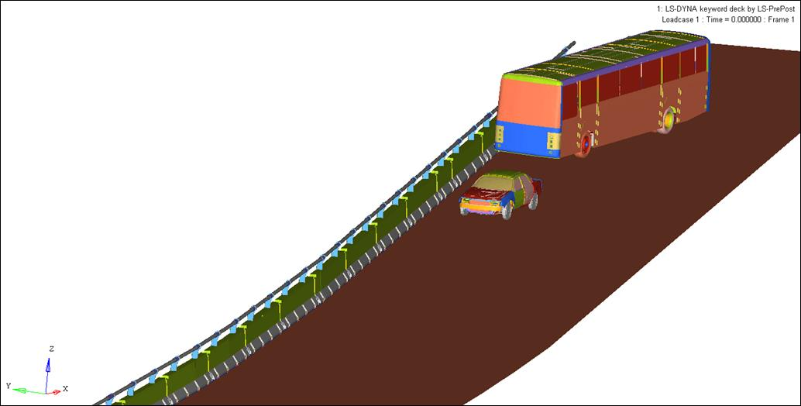
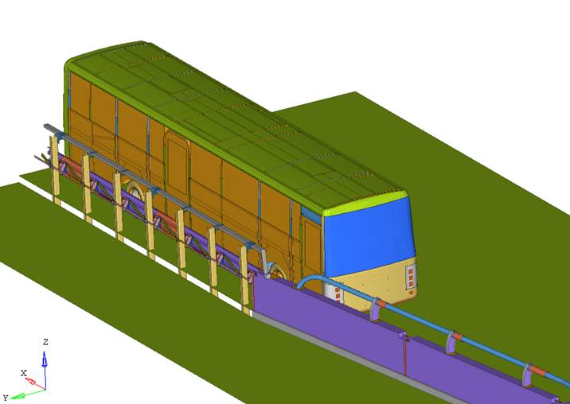
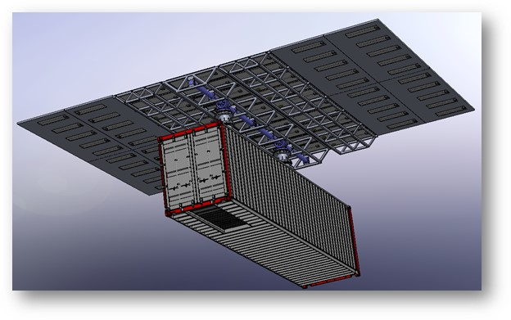
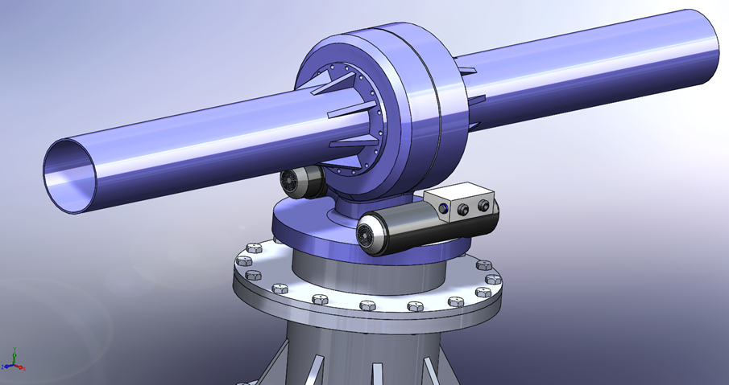
Our competences applied in others fields
Reconstruction of road accidents
Mechatronic applications
Automatic solar container
Crash analysis
Road safety
Collision model against fixed obstacles
Collision beetwen vehicles
Motion after collision
Motion of trasport object during impact (fixed or mouvable
Copyright © AnKers juss- amg , Privacy Statement Terms and Conditions

Slide 8
Ankers software development
Copyright © AnKers juss- amg , Privacy Statement Terms and Conditions

Slide 9
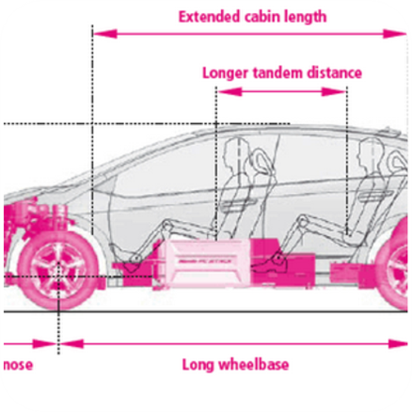

A.V.T.
Ankers Vehicle Tool
Ankers for RotoDynamic
(A4RD)
Copyright © AnKers juss- amg , Privacy Statement Terms and Conditions

Slide 10
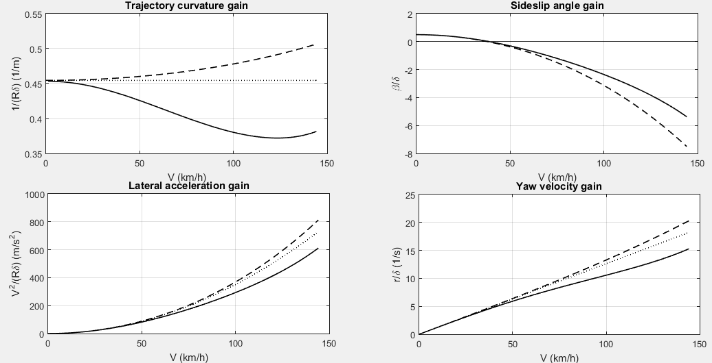
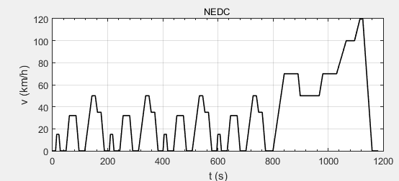
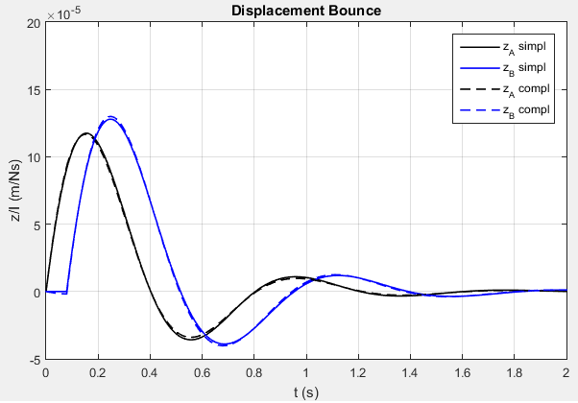
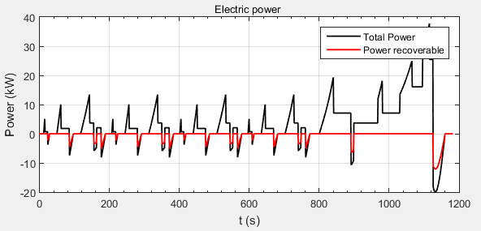
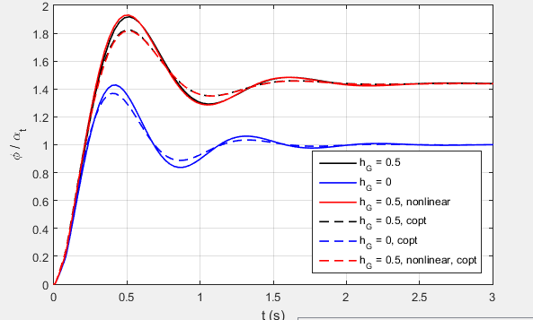
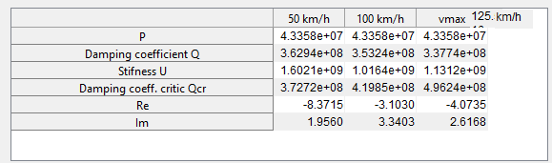
Ankers Vehicle Tool (A.V.T)
The code is a propietary toolbox designed to perform the preliminary uncoupled analysis of the longitudinal behavior (including fluel consumption), the handling behavior, the confort of motor vehices. Tool particularly suitable for dimensioning hybrid and full electric vehicles.Custom plug-in covers a wide range of cases,from open wheel racing to industrial heavy vehicles. Further customization can be made to satisfy customers requirements
Longitudinal dynamic
Power required
Acceleration performance
2 dof suspension
Pitch oscillation
Vertical dynamic
Lateral dynamic
Steady state Handling
Steady-state with drive wheel
Battery consumption
Roll motion
Stabilty
Locked controls stability
Step steering input
Wind gust input
Driver model
Copyright © AnKers juss- amg , Privacy Statement Terms and Conditions

Slide 11
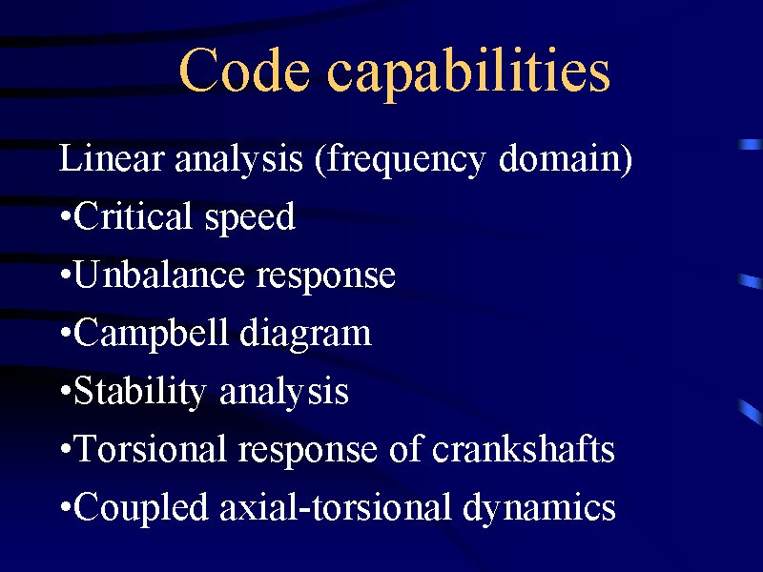
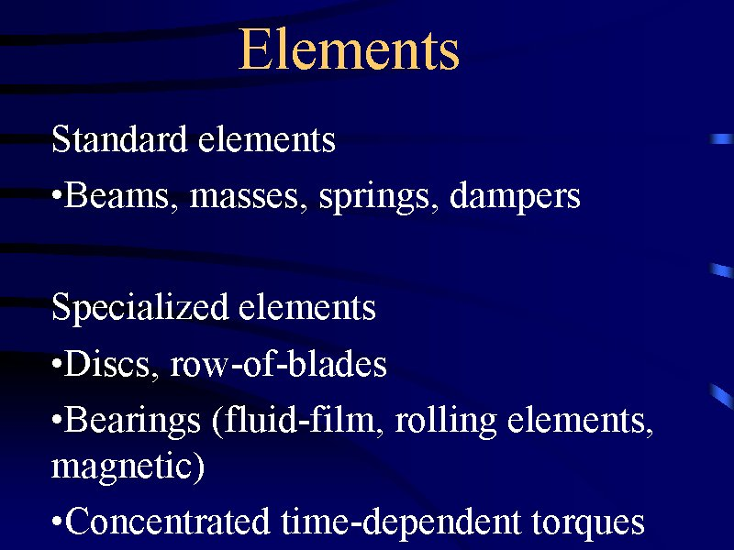
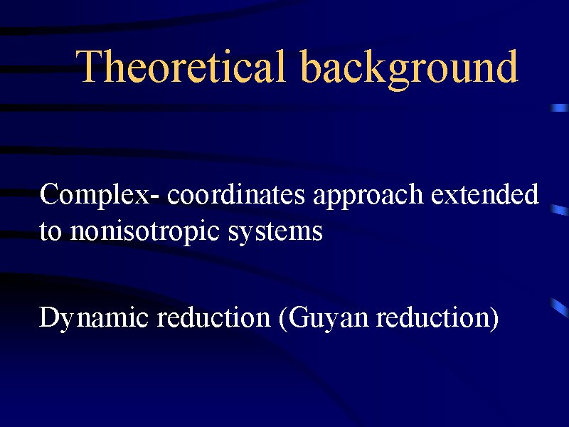
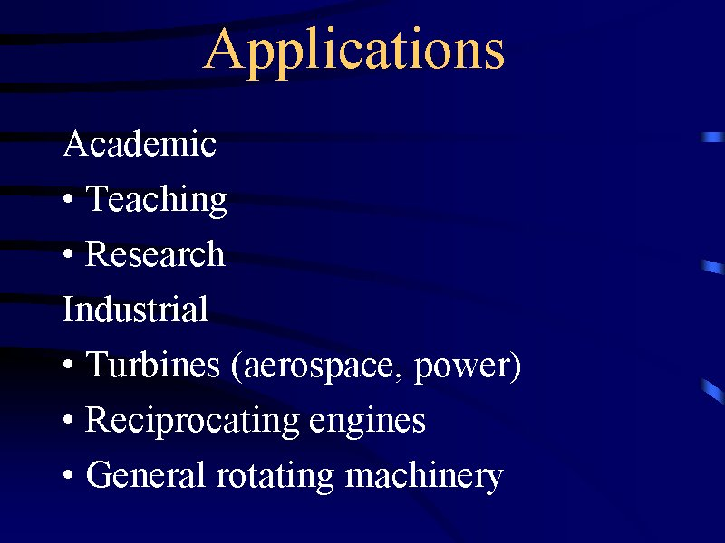
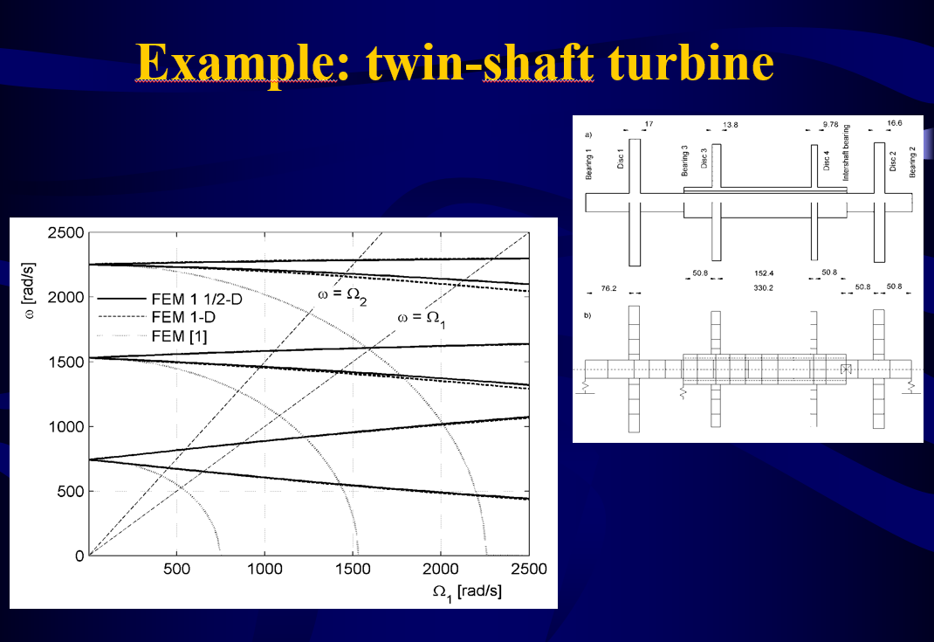

Ankers for RotorDynamic (A4RD)
Copyright © AnKers juss- amg , Privacy Statement Terms and Conditions

Slide 12

CONTACTS
ANKERS juss-amg
www.Ankers.it
info@ankers.it
Registered Office
Via Roma, 32
10095 Grugliasco (TO)
Phone/Fax: +39 011 19502592
Operational Headquarters
Corso Orbassano, 336
10137 TORINO
Phone: +39 011 9588564
Fax: +39 011 9591409
Via Baldassarre Castiglione, 55
00142 ROMA
Phone/Fax: + 39 06 95 22 62 08
Andrea Chiumello
Mob: +39 347 5521211
Email: andrea.chiumello@ankers.it
Alessandro Genta
Mob: +39 347 3632783
Email: alessandro.genta@ankers.it
Copyright © AnKers juss- amg , Privacy Statement Terms and Conditions

